Slide 1


S7

Slide 2

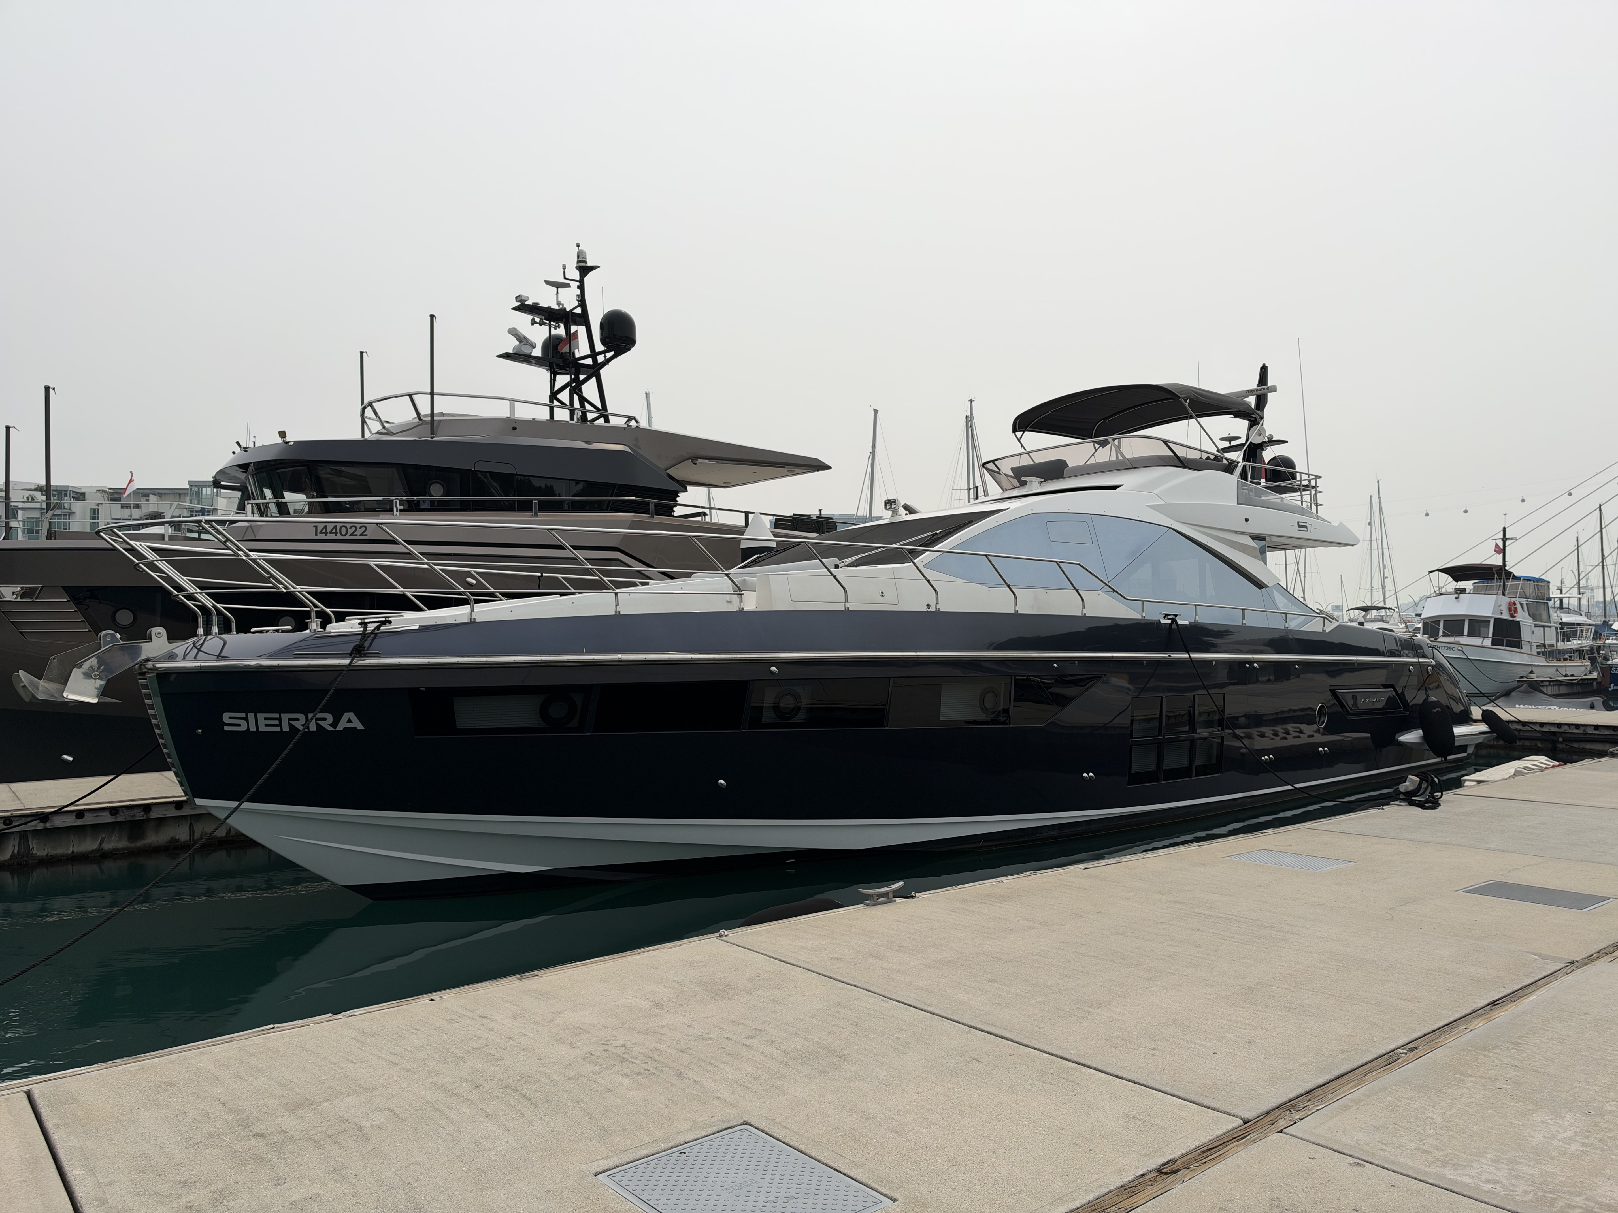

Slide 3
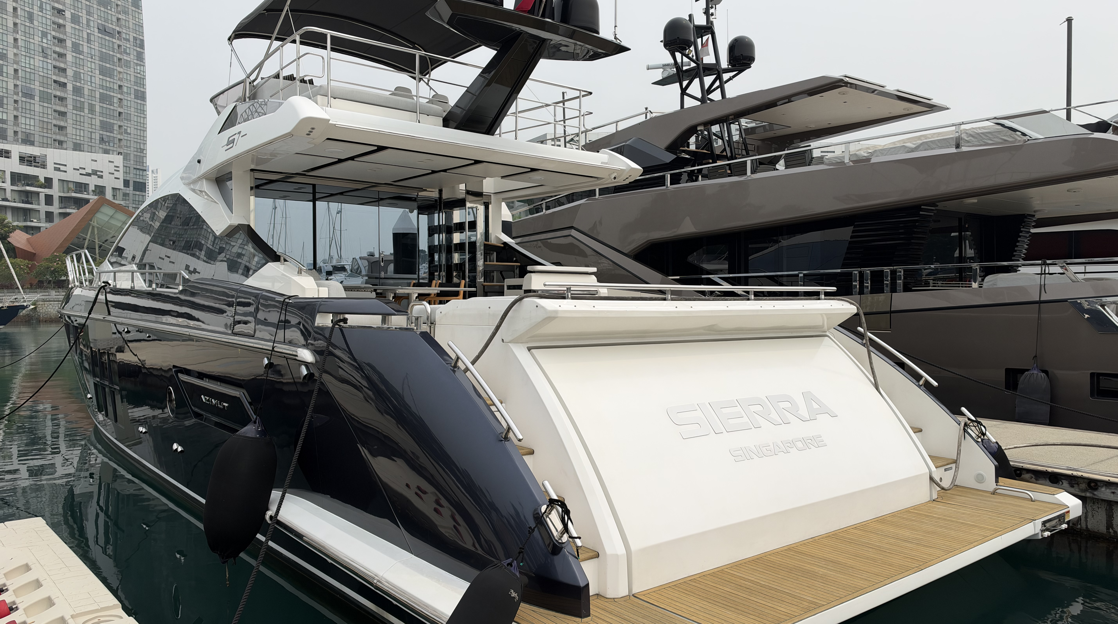
- 2021
€1,950,000

Slide 4
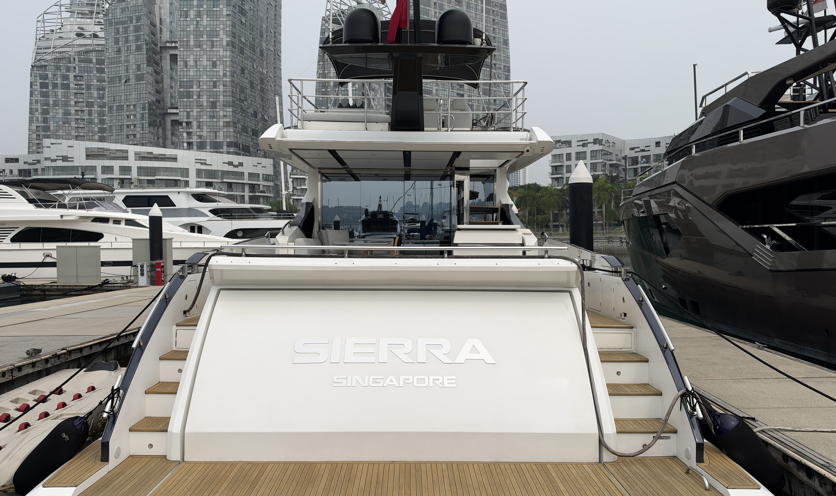
Garage
- 2021

Slide 5
Cockpit
- 2021

Slide 6
Cockpit
- 2021

Slide 7
Saloon & Dinette
- 2021

Slide 8
Galley
- 2021

Slide 9
Master Cabin
- 2021

Slide 10
Master Cabin head
- 2021

Slide 11
Guest Cabins
- 2021

Slide 12
Guest Cabin head
- 2021

Slide 13
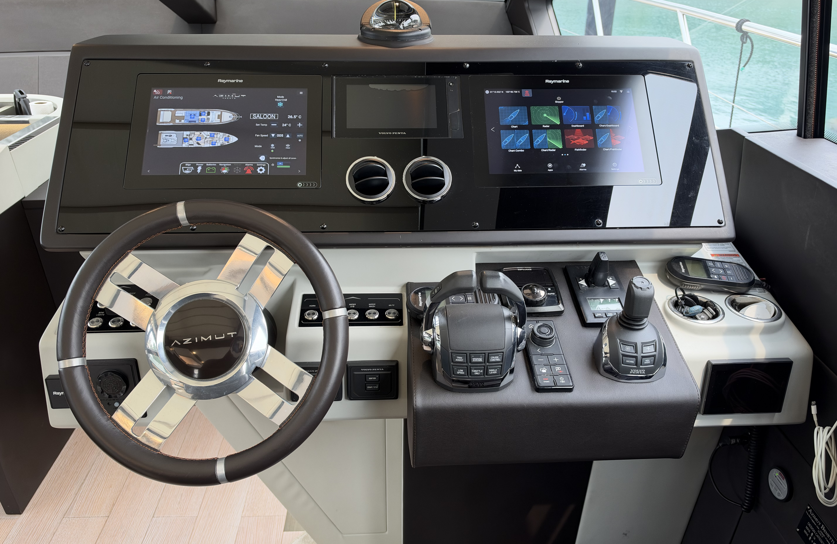
Helm
- 2021

Slide 14
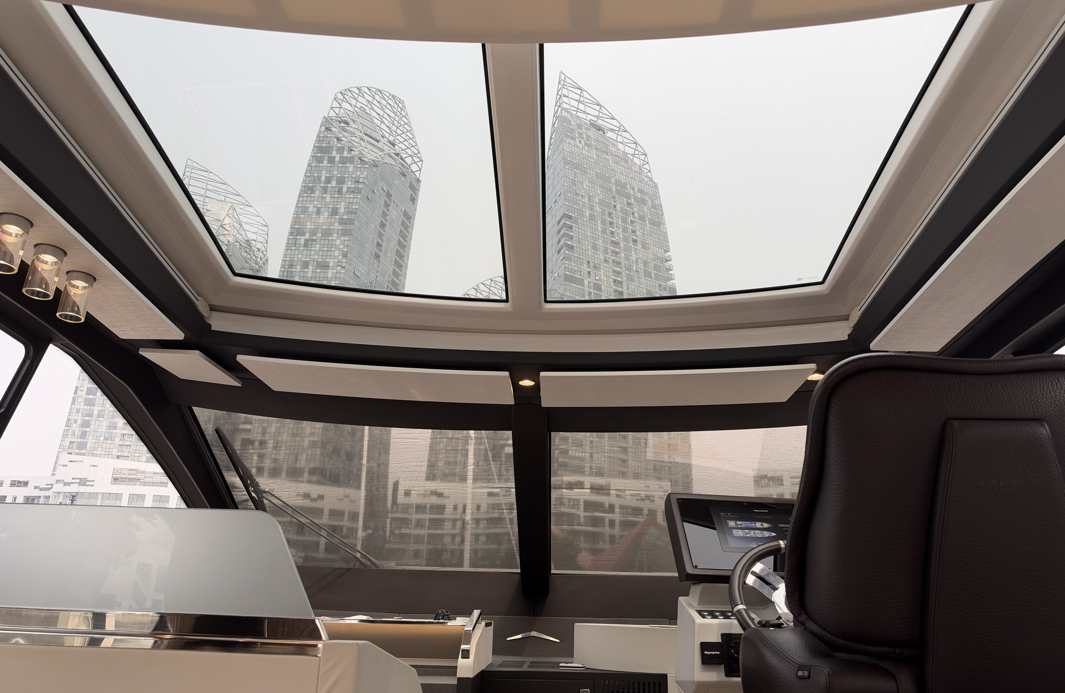
Sunroof
- 2021

Slide 15
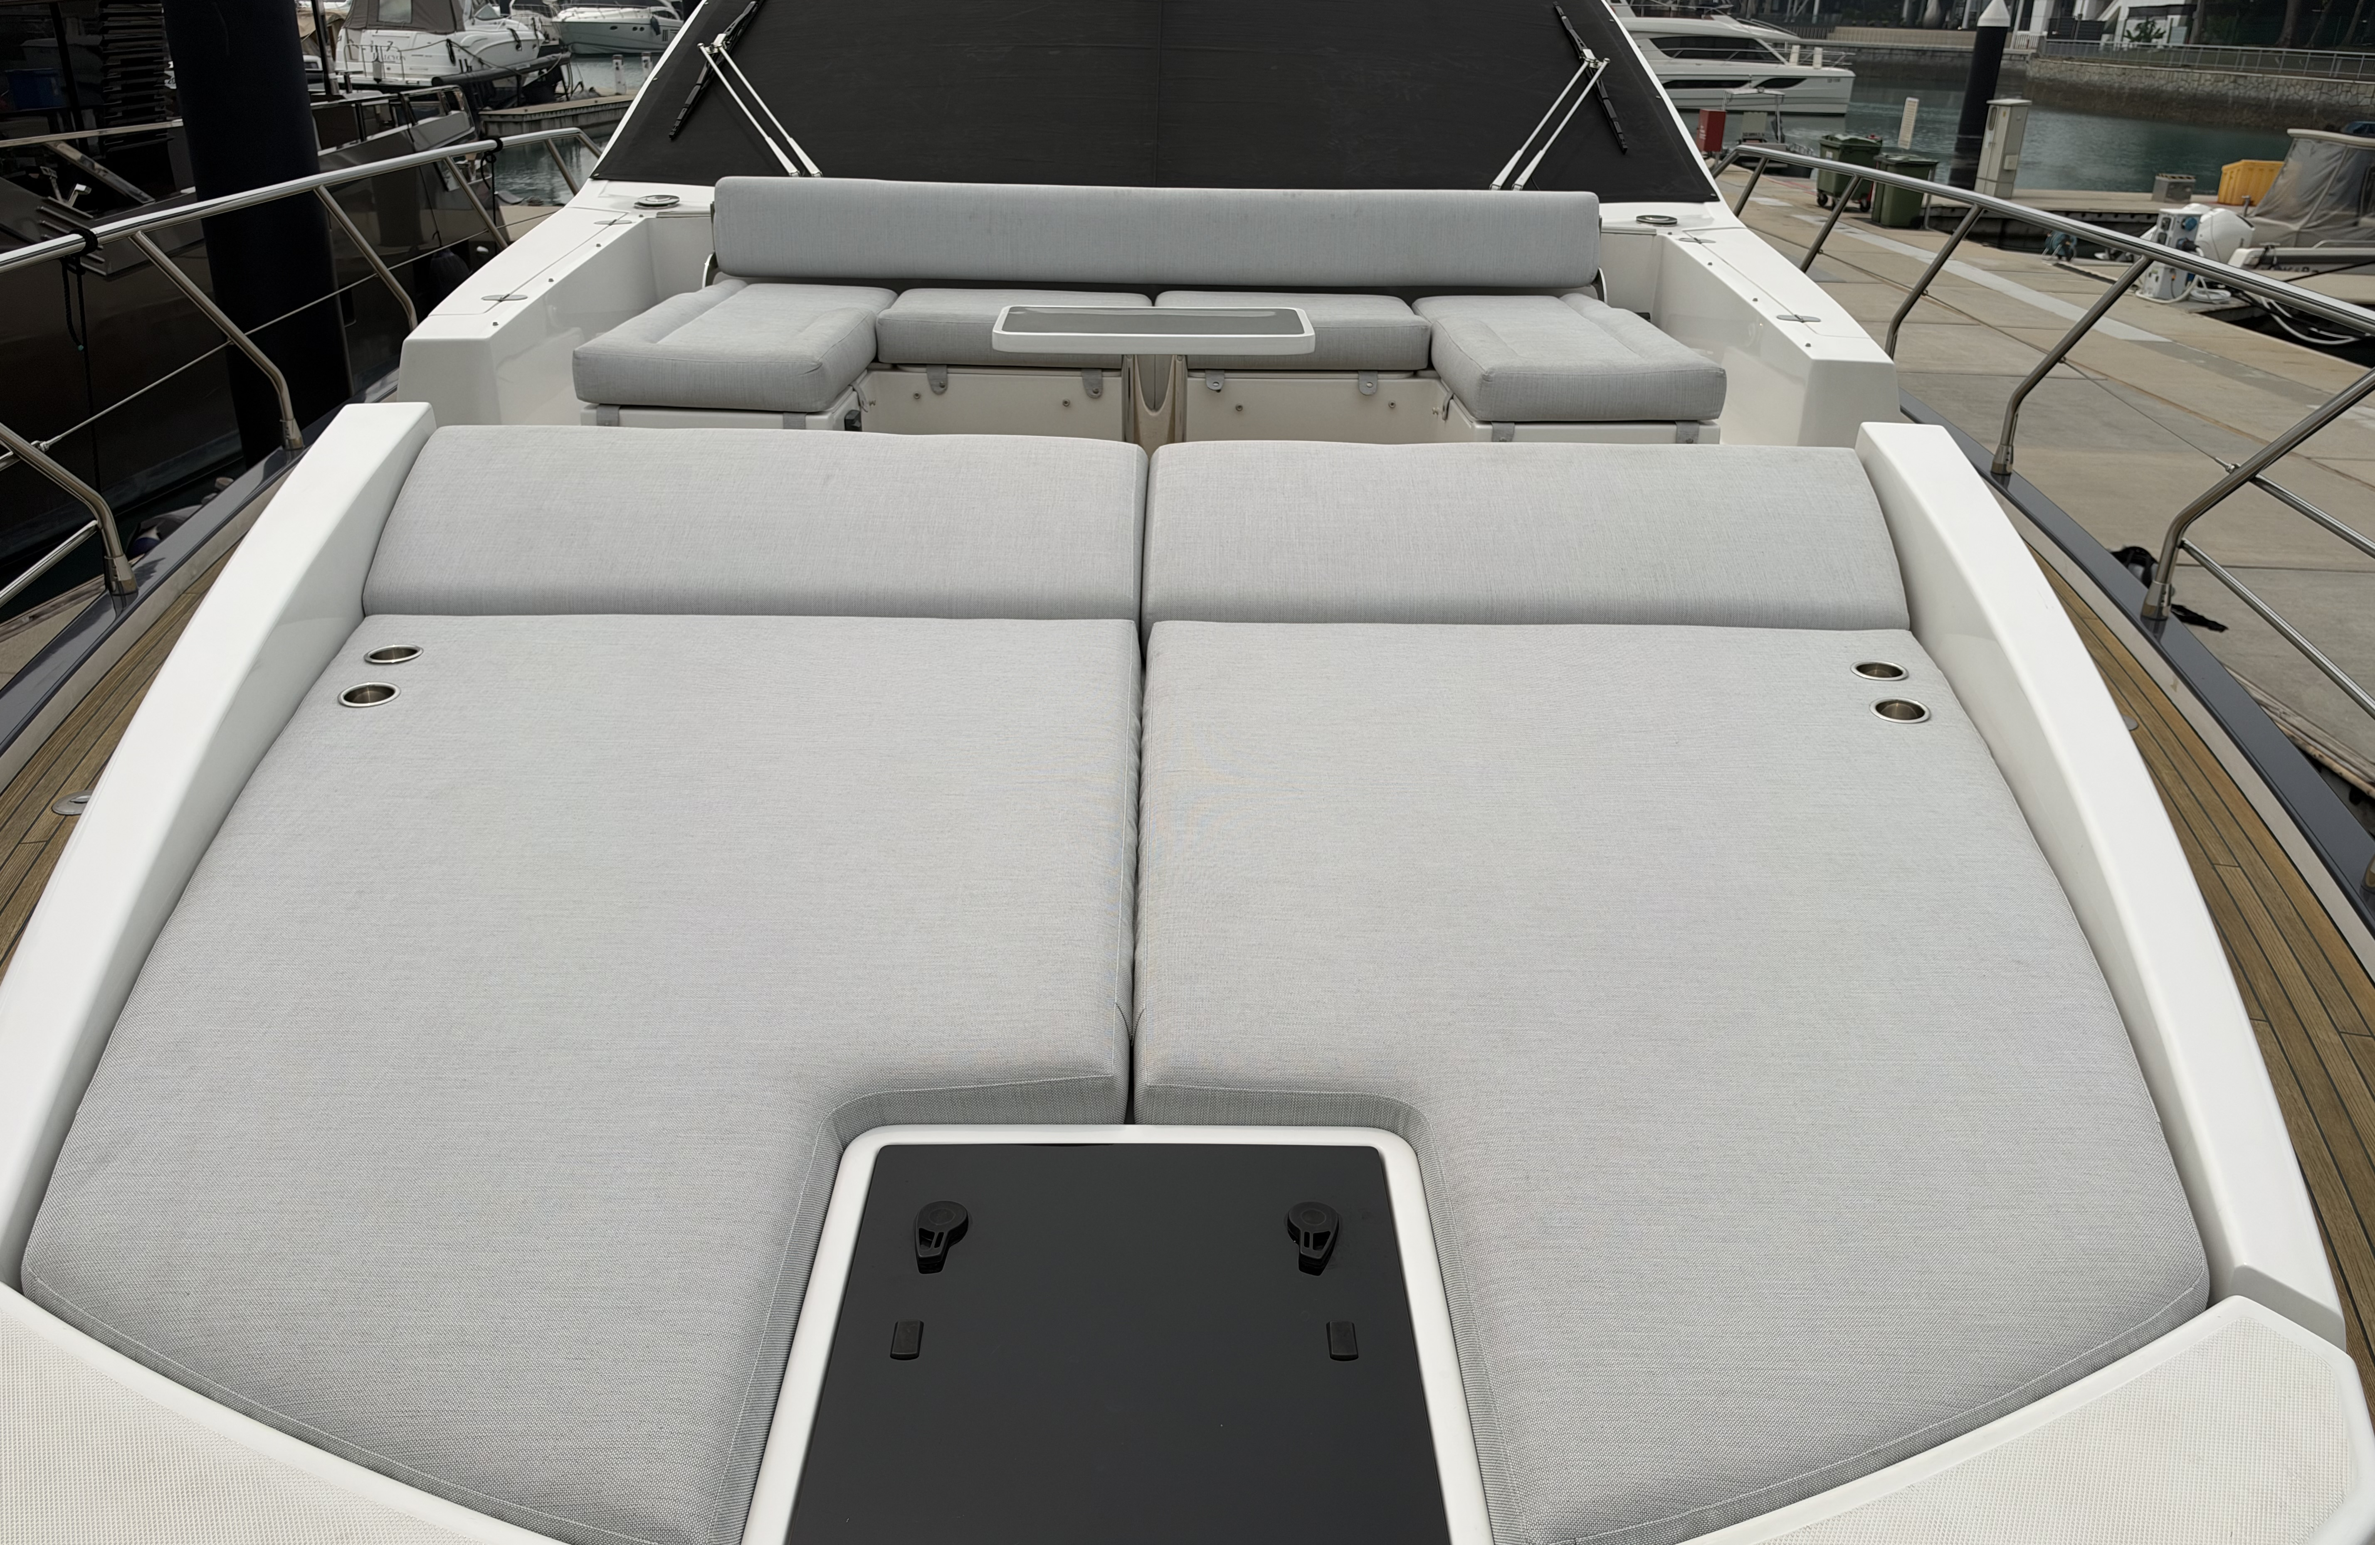
Foredeck Lounge
- 2021

Slide 16
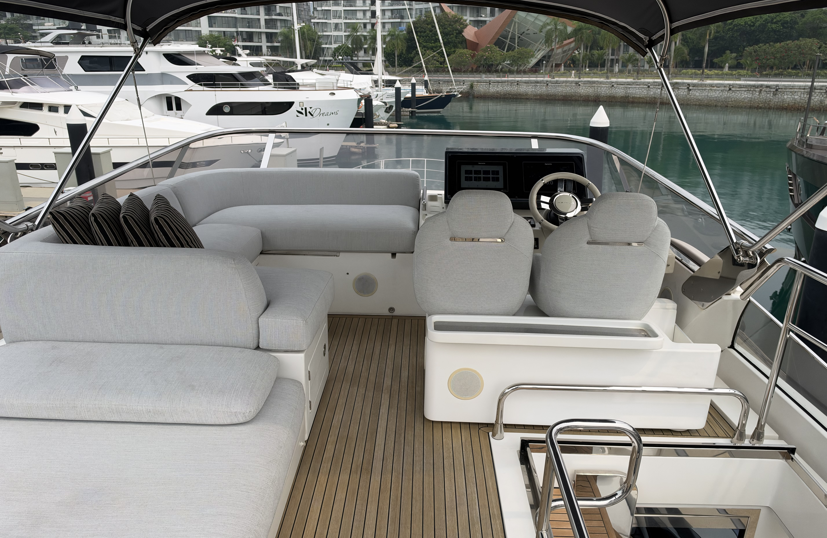
Sportfly
- 2021

Slide 17
BOAT DETAILS
LENGTH OVERALL | 21,37 m | 70‘ 1”
BEAM MAX | 5,3 m | 17’ 5”
DISPLACEMENT | 45,4 t | 100089 lb
ENGINES | 3 x VOLVO IPS 1050 D13 800 hp | Hours:
MAXIMUM SPEED | Up to 36 kn
CRUISING SPEED | 29 kn
FUEL CAPACITY | 3800 l | 1004 US Gal
WATER CAPACITY | 1000 l | 264 US Gal
CABINS | 4 + 1 crew
BERTHS | 8 + 2 crew
HEAD COMPARTMENTS | 3 + 1 crew
BUILDING MATERIAL | Carbon fibre + GRP
EXTERIOR DESIGNER | Stefano Righini
INTERIOR DESIGNER | Francesco Guida
HULL DESIGNER | P.L. AUSONIO Navel Architecture & Azimut R&D Dept.
BUILDER | Azimut Yachts
CERTIFICATION | CE Category A - NMMA
Disclaimer:
In this case, we are acting as Brokers only, all information is provided in good faith but we cannot guarantee the accuracy or the condition of the vessel. Any prospective buyer is encouraged to employ an independent surveyor to inspect the vessel and confirm the details and condition of the vessel on their behalf.
T: +65 6358 2136 www.marineitalia.asia
M: +65 8894 5059 david@marineitalia.asia

Slide 18
BOAT DETAILS
OPTIONS LIST
  Advanced Package
  Additional Seakeeper gyro control station on fly
  Carbon dioxide detectors
  Cockpit docking station and bow thruster
  Dynamic positioning system Volvo – skyhook
  Glendenning cable master – auto reel shorepower cable
  Seakeeper gyro stabilizer NG 16
  Bimini on fly (manual)
  Bow sofa on fly convertible in sunbathing area
  Cockpit sun awning (automatic)
  Cockpit table with carbon finishing top
  Co-pilot seat on flybridge
  Hauling-launching system for jetski
  LED spotlights on aft fly
  Sunbathing cushions on aft fly in Batyline fabric
  Table on bow (fixed_
  Teak on flybridge
  Telescopic gangway
  Underwater lights (n.3 on transom and n.2 on sides, one for each side)
  Upgrade standard external cushions in Batyline frabic
  Bidet in master head
  Co-pilot seat in main helm
  Electric blackout awning for saloon sunroof
  Lighting Luxury Package including saloon ceiling dimmerable light panel, galley glass led spotlights (3), applique Fontana Arte in salon (2), applique Tokomeo in VIP cabin (2)
  Safe in master cabin
  Table lamp mod, Mezza Chimera Artemide
  Toilet with bidet faucet in VIP bathroom
  Wooden floor in lower lobby
  Wooden floor in salon
  Barbecue in cockpit
  Dishwasher
  Washer + dryer (two separate units)
  Raymarine AIS 700 – Vessel Location & ID safety system
  Raymarine fishfinder
  Raymarine Gold navigation package
  Raymarine additional VHF handset
  High-low system for TV salon
  Audio Video TV Pack – for saloon, Master Cabin, Cockpit, Flybridge & Bow
  Mosquito nets for port holes
  2 x st of fitted bed linen for all guest beds
  Raymarine video cameras x 3, connected tp helm navigation displays
  Bow sunshade with removable poles
  Painted hull sides and gunwhales, as per brochure
  Bauer Jnr II 230V Dive compressor in engine room with P21 filtration system and 2 way manifold installed in the garage, including 6 x AL80 dive bottles with storage in the garage and cockpit locker
T: +65 6358 2136 www.marineitalia.asia
M: +65 8894 5059 david@marineitalia.asia

Slide 19
BOAT DETAILS
Raymarine Gold Navigation Package
  Sportfly
  2 Display multifunction – Axiom+ 12
  1 VHF station Ray 90
  RMK-10
  Main Helm (Internal)
  2 Display multifunction – Axiom+ 12
  1 VHF station Ray 90 (option)
  RMK-10
  Sensor
  Open Array Magnum 4kW 48”
  Trsd. SMART DST810
  6 x CCM-116
  MCU-150
T: +65 6358 2136 www.marineitalia.asia
M: +65 8894 5059 david@marineitalia.asia

Slide 20
BOAT DETAILS
Audio/Video Package
  Main Saloon
  1 LG 55" LED HD Smart TV (or equivalent)
  1 DVD BLUERAY
  1 Home Thearte BOSE Lifestyle 600 (or equivalent)
  Sportfly
  4 2 way speakers Fusion 6” w/ set covers
  1 Amplifier Fusion FM 504
  1 Fusion Uni-dock MS-UD750
  Cockpit
  2 2 way speakers Fusion 6” w/ set covers
  1 Amplifier Fusion FM 504
  1 Subwoofer Fusion 10” 400 W
  1 Remote Control Fusion
  Bow
  2 2 way speakers Fusion 6” w/ set covers
  Master Cabin
  1 SAMSUNG 49” LED TV (or equivalent)
  3 ACOUSTIMASS 5 BOSE System
  1 Amplifier Denon
  VIP Cabins (equipment list for each cabin)
  1 LG 32” LED TV(or equivalent)
  1 BOSE Solo 5 TV Soundbar
  Guest Cabins (equipment list for each cabin)
  1 LG 24” LED TV(or equivalent)
  1 BOSE Solo 5 TV Soundbar
  Crew’s Cabin
  1 LG 24” LED TV(or equivalent)
T: +65 6358 2136 www.marineitalia.asia
M: +65 8894 5059 david@marineitalia.asia

Slide 21
BOAT DETAILS
EXCLUSIVE/CENTRAL LISTING
Elegant, athletic and effortlessly stylish, the Azimut S7 is a sportfly yacht that turns heads in any marina. Her carbon fibre and fibreglass construction makes her light, strong and remarkably stable, while triple Volvo Penta IPS engines deliver smooth, responsive performance and exceptional manoeuvrability.
Inside, the salon is bright and contemporary, blends the interior with the outdoor living spaces. Guests can relax on the sportfly sun pad, soak up the sun on the bow, or dine in the shade at the aft cockpit. A teak swim platform makes getting in and out of the water easy, and the generous stern garage keeps the tender and water toys neatly stowed. Below deck, the owner’s suite, guest cabins and separate crew quarters give everyone comfort and privacy.
This S7 is in excellent condition and has been well maintained, ready to be enjoyed from the moment you step aboard. Viewings are available by appointment, so please get in touch to arrange yours.
T: +65 6358 2136 www.marineitalia.asia
M: +65 8894 5059 david@marineitalia.asia

Slide 22
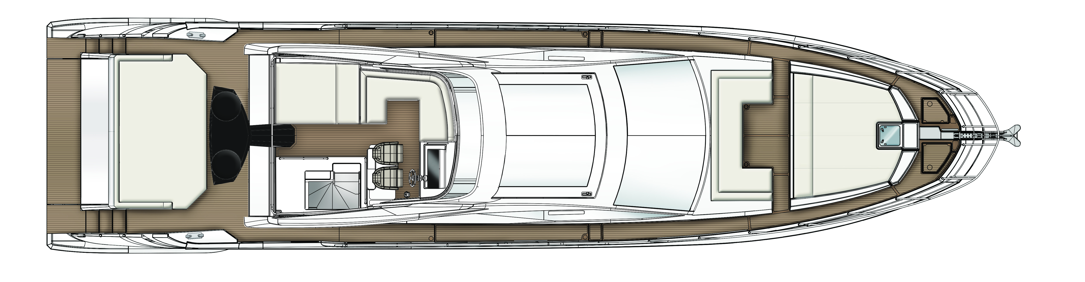
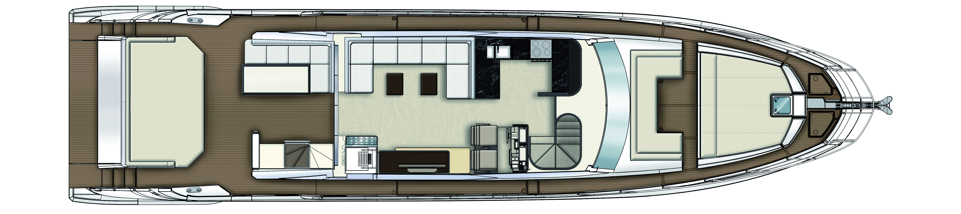
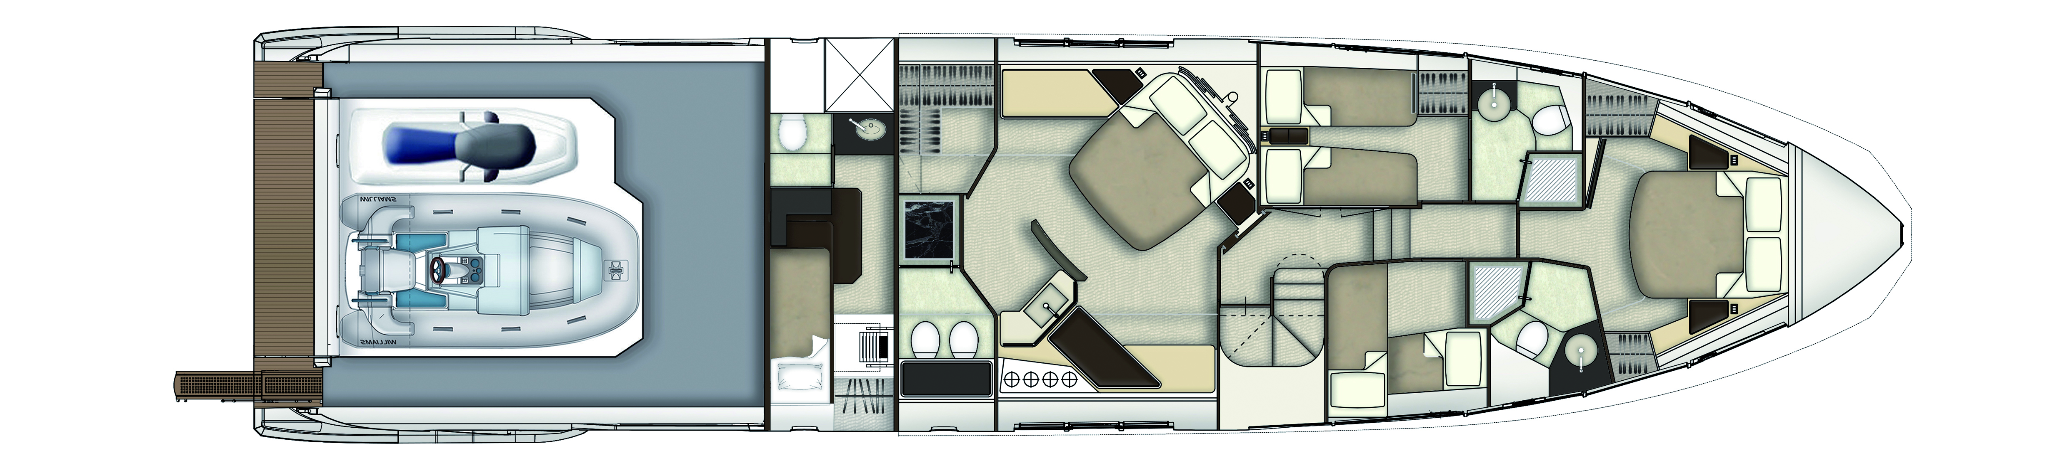
FLY BRIDGE
MAIN DECK
LOWER DECK
T: +65 6358 2136 www.marineitalia.asia
M: +65 8894 5059 david@marineitalia.asia

